Slide 1
Hydraulics
By John Templeton

Slide 2
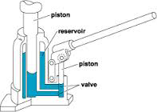
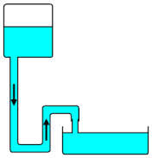
Hydraulics
Definition- the science that deals with the laws governing water or other liquids in motion and their applications in engineering; practical or applied hydrodynamics.

Slide 3
Definition Cont.
Pressure- Restriction to flow
Liquid can not be compressed in a hydraulic system only displaced.

Slide 4
Pumps
Pumps create flow in a hydraulic system.
Pumps can be powered by electric motor or an engine.
Types
Vane, Piston and Gear

Slide 5
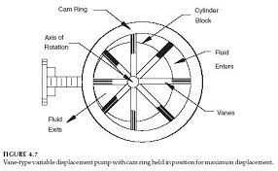
Vane Pumps
Uses individual vanes to create flow

Slide 6
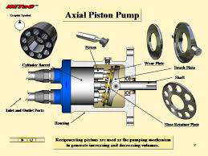
Piston Pump
Uses the movement of pistons to create flow similar to an engine.

Slide 7
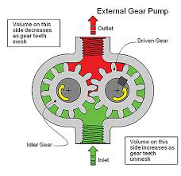
Gear Pump
Used the movement of two interlocked gears to create flow.

Slide 8
Hydraulic Actuators
A device which converts hydraulic power into mechanical force and motion

Slide 9
Single Acting Cylinder
Uses one port to allow flow in and out

Slide 10
Double Acting Cylinder
Has two ports to allow flow in and out.
Which direction will apply more force?

Slide 11
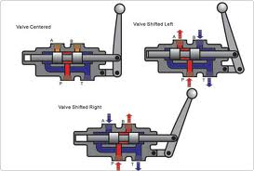
Hydraulic Valves
A device which controls either 1) pressure of fluid, 2) direction of fluid flow, or 3) rate of flow.

Slide 12
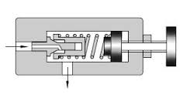
Relief Valves
Send excess pressure back to reservoir to prevent damage to system

Slide 13
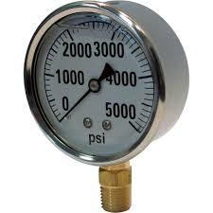
Measuring Pressure
Liquid filled gauges are used to measure force.

Slide 14
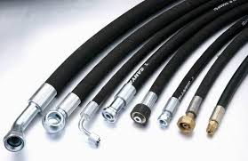
Hydraulic Hoses
Hoses are used to transfer flow from valves, pumps to actuators.
When checking for leaks do not use hands use cardboard.
Are made of steel braided material and covered in rubber to prevent damage.

Slide 15
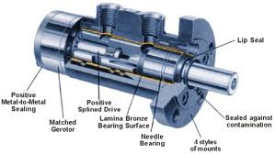
Hydraulic Motors
A hydraulic motor is a mechanical actuator that converts hydraulic pressure and flow into torque and angular displacement (rotation). The hydraulic motor is the rotary counterpart of the hydraulic cylinder.

Slide 16
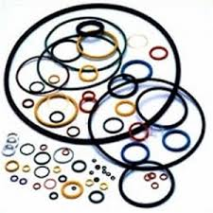
O-rings
Used to provide sliding and static seals in a hydraulic system.

