Slide 1
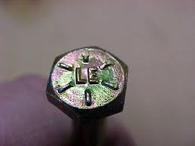
32. What is the grade of this bolt?

Slide 2
33. What is the grade of this bolt?

Slide 3
34. What is the grade of this bolt?

Slide 4
Bonus: What is this?

