Slide 1
Pneumatic Tool Safety
By John Templeton

Slide 2
Objective
Identify safety precautions used when operating pneumatic tools.

Slide 3
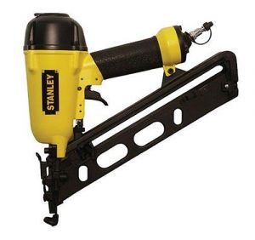
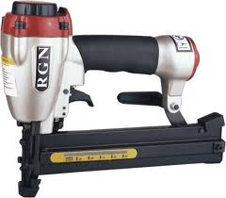
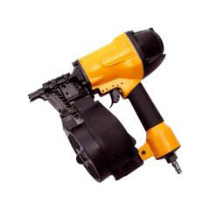
Definition
____________________________________________________________________________________________________________________________________

Slide 4
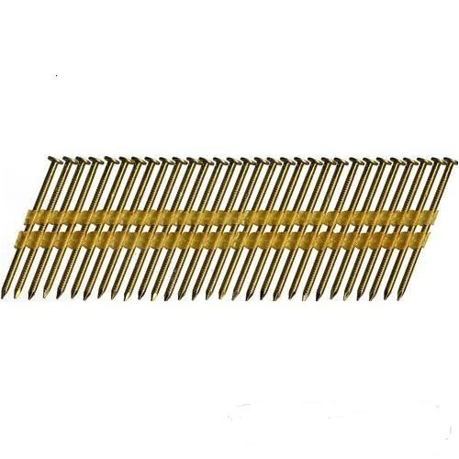
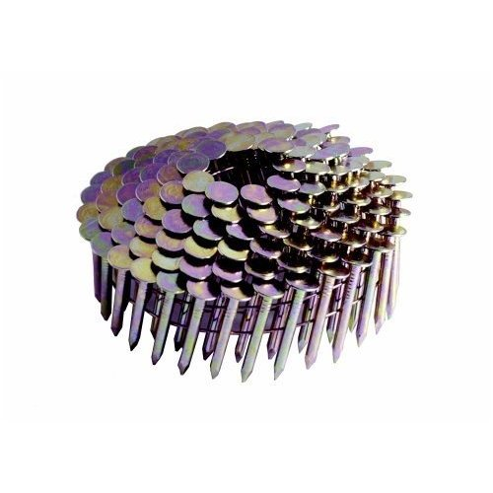
Nails
Nails come in different forms for different purposes.
________________________________________________________________________________________

Slide 5
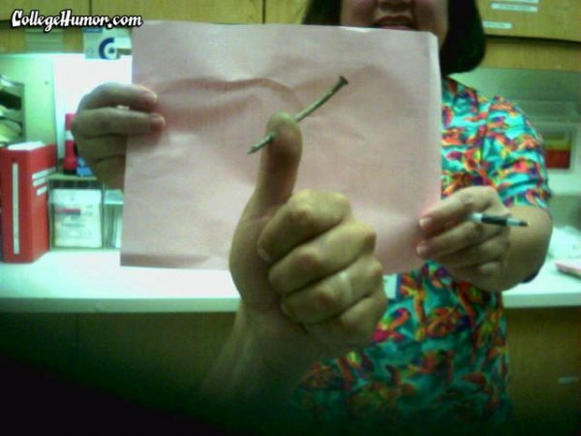
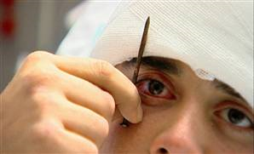
Safety
There are several dangers associated with the use of pneumatic tools.
____________________________________________________________________________________________tool’s attachments or by some kind of fastener the worker is using with the tool.

Slide 6
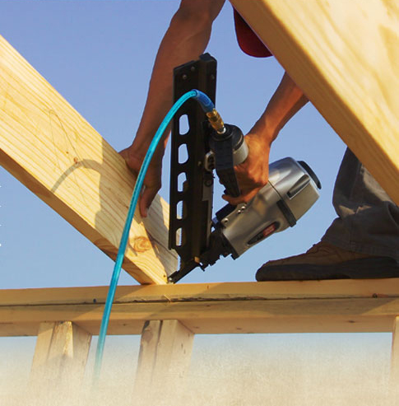
Safety
Pneumatic tools must be checked to see that the tools are fastened securely to the air hose to prevent them from becoming disconnected.
______________________________________________________________________________________ attaching the air hose to the tool must also be used and will serve as an added safeguard.

Slide 7
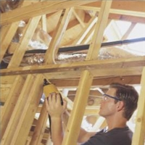
Safety
Eye protection is required, and head and face protection is recommended for employees working with pneumatic tools.
_______________________________________________________________________________________.

Slide 8
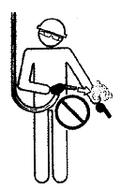
Safety
Use common sense when operating compressed air tools.
Never spray above the neck or point tools in the direction of someone
Stay clear of tool exhaust
______________________________________________

Slide 9
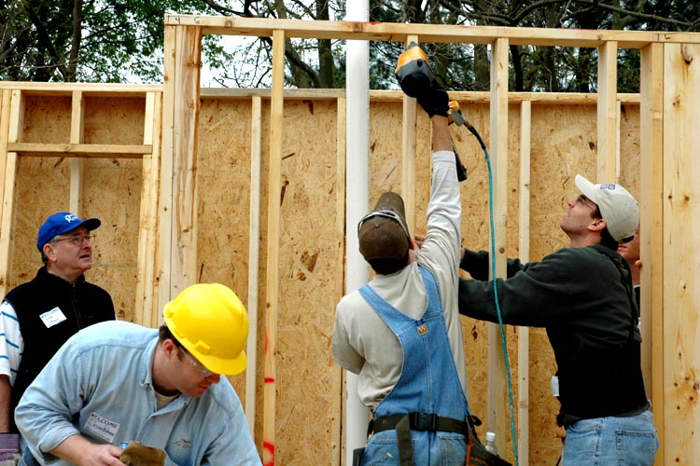
Safety
_______________________________________________________________________________________.

Slide 10
Air Hoses
The same precautions should be taken with an air hose that are recommended for electric cords, because the hose is subject to the same kind of damage or accidental striking, _______________________________________________________________________________________.

Slide 11
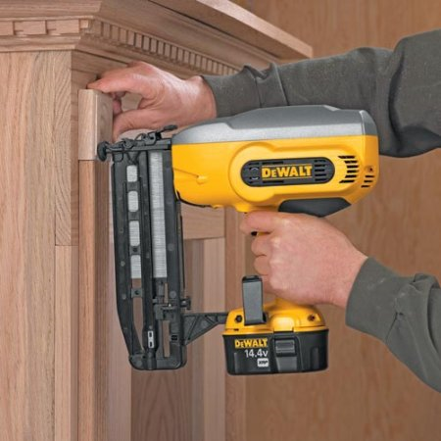
Safety Devices
Pneumatic tools that shoot nails, rivets, staples, or similar fasteners and operate at pressures more than _________________________square inch (6,890 kPa), must be equipped with a special device to keep fasteners from being ejected, unless the muzzle is pressed against the work surface.

Slide 12
Activity
Develop 10 safety rules for using the pneumatic air tools in our shop.

