Slide 1
Plumbing
From foukeffa.org
Written by Dale Conrady
Edited by Danell Woolery

Slide 2
Objective
Identify common types of plumbing tools and describe their proper use.
Identify common types of pipe, pipe fittings, and plumbing fixtures, and describe their proper use.

Slide 3
Tools
Bench yoke vice
Chain vice
Chain wrench
Pipe wrench

Slide 4
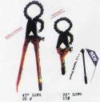
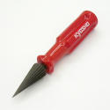
Tools cont.
Hacksaw
File
Pipe Cutter
Reamer

Slide 5
Tools
Tubing cutter
Tap and Dies
Flaring tool
Flaring Block

Slide 6
Identification
The nominal, or identifying size of pipe is generally based on the:
Inside diameter (ID)
Outside diameter, (O D)
Common sizes used for home or farm are 1/4, 3/8, 1/2, 3/4, 1, 1 1/4 1 1/2, 2, 2 1/2, 3, 4, 6 inch

Slide 7
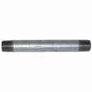
Steel Pipe
Black or Galvanized
Black pipe is painted and has very little resistance to rust.
Galvanized pipe is coated with zinc inside and out and has very good resistance to rust.

Slide 8
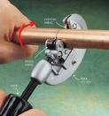
Copper Tubing
Pipe made of copper is frequently referred to as tubing.
This tubing is soft and can be bent around irregular shapes so that it can be installed easily. It is preferred to steel because it resist corrosion.

Slide 9
Classification
Standard has a specific Inside Diameter (ID) and Outside Diameter (OD)
Extra Heavy and Double extra heavy have heavier walls, although the outside diameter (OD) remains the same, the inside diamter (ID) changes.
All standard fittings will work with the 3 different styles of pipe

Slide 10
Classification
Type K is the heaviest
Type L is medium
Type M is the lightest

Slide 11
Joining
Copper pipe may be joined in three ways.
1. Soldering
2. Flaring
3. Compression

Slide 12
Plastic Pipe
Plastic is the easiest type of pipe to install.
The term plastic is used to include all pipe made of synthetic materials.

Slide 13
Types of Plastic
PVC (Polyvinyl Chloride)
Used for cold water or waste water applications
CPVC (Chlorinated Polyvinyl Chloride) used for hot water applications
ABS (Acrylonitrite Butadiene Styrene) used for underground applications

Slide 14
Joining
CPVC, PVC and ABS all are joined by gluing.
PE must have hose barbs and band clamps

Slide 15
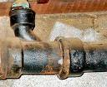
Cast Iron
Sewer installations
Available in sizes from 2 in to 6 in.
Single Hub or Double Hub

Slide 16
Joining
Oakum and lead
Neoprene gaskets

Slide 17
Wirsbo Pipe
Rquires certification before commercial use
Most common in new homes
Uses special fittings
Can be joined easily with special tool

Slide 18
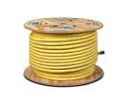
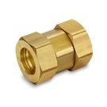
Gas pipe
Use in the place of copper and steel pipe
Joined easily with compression fittings

Slide 19
Pipe Fittings

Slide 20
Review
What are some commonly used tools in plumbing?
Size of pipe is based on what two (2) things?
What types of pipe are used in plumbing?
What types of fittings are used for copper tubing?

