Slide 1
Pneumatic Tool Safety
By John Templeton

Slide 2
Objective
Identify safety precautions used when operating pneumatic tools.

Slide 3
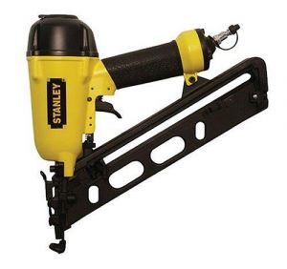
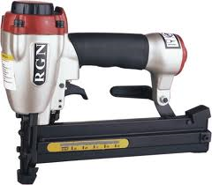
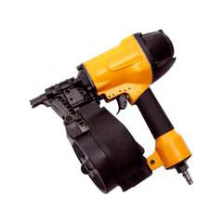
Definition
Pneumatic tools are powered by compressed air and include chippers, drills, hammers, and sanders

Slide 4
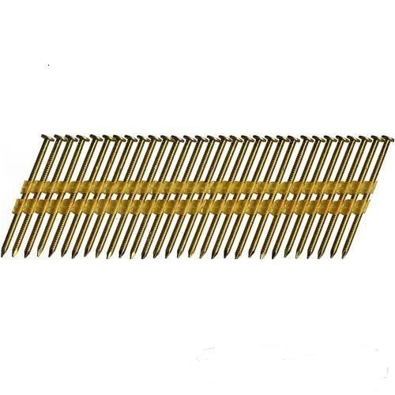
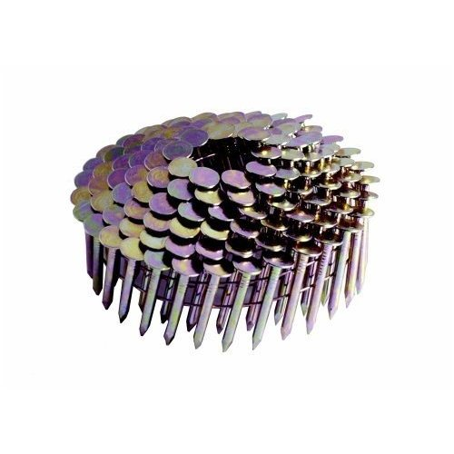
Nails
Nails come in different forms for different purposes.
Each is for a specific nail gun

Slide 5
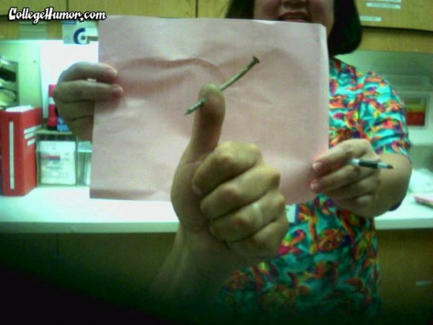
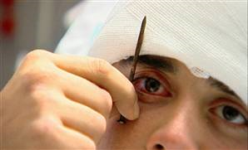
Safety
There are several dangers associated with the use of pneumatic tools.
First and foremost is the danger of getting hit by one of the tool’s attachments or by some kind of fastener the worker is using with the tool.

Slide 6
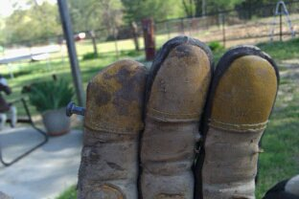

Slide 7
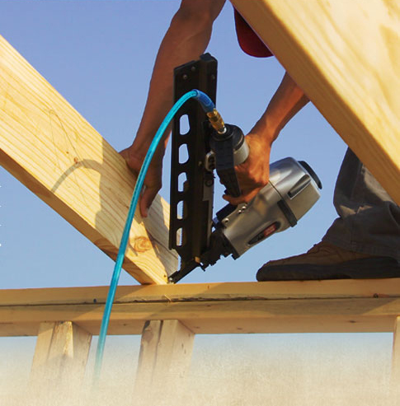
Safety
Pneumatic tools must be checked to see that the tools are fastened securely to the air hose to prevent them from becoming disconnected.
A short wire or positive locking device attaching the air hose to the tool must also be used and will serve as an added safeguard.

Slide 8
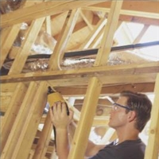
Safety
Eye protection is required, and head and face protection is recommended for employees working with pneumatic tools.
Compressed air guns should never be pointed toward anyone.

Slide 9
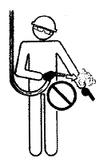
Safety
Use common sense when operating compressed air tools.
Never spray above the neck or point tools in the direction of someone
Stay clear of tool exhaust
Do not carry tools by hoses

Slide 10
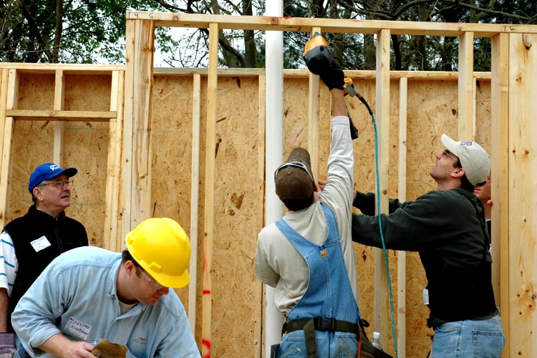
Safety
Use tools in comfortable positions as much as possible to prevent fatigue.

Slide 11
Air Hoses
The same precautions should be taken with an air hose that are recommended for electric cords, because the hose is subject to the same kind of damage or accidental striking, and because it also presents tripping hazards.

Slide 12
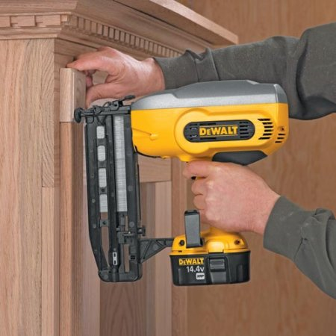
Safety Devices
Pneumatic tools that shoot nails, rivets, staples, or similar fasteners and operate at pressures more than 100 pounds per square inch (6,890 kPa), must be equipped with a special device to keep fasteners from being ejected, unless the muzzle is pressed against the work surface.

